Slide 1
LAB-05
SAJJAD ALI RAJPER
LECTURER
AROR UNIVERSITY

Slide 2
Switch case statement
The switch case statement is used when we have multiple options and we need to perform a different task for each option.

Slide 3
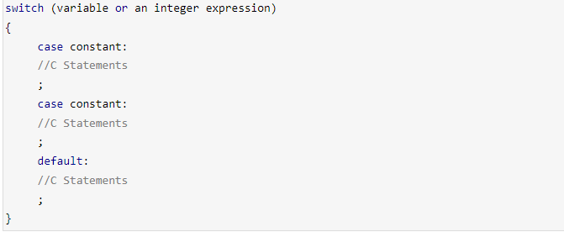
Switch case statement – Syntax

Slide 4
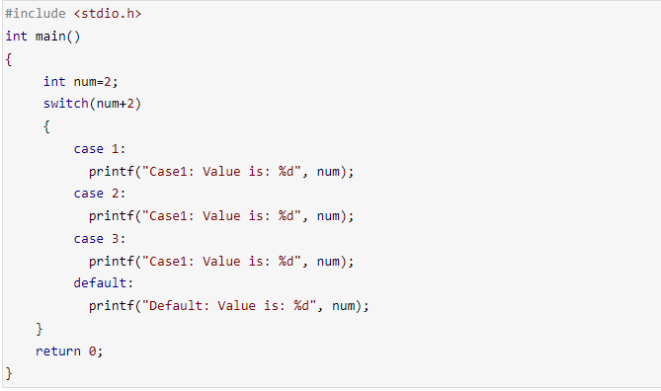
Switch case statement – Example
Notes:
Explanation: In switch I gave an expression, you can give variable also. I gave num+2, where num value is 2 and after addition the expression resulted 4. Since there is no case defined with value 4 the default case is executed.

Slide 5
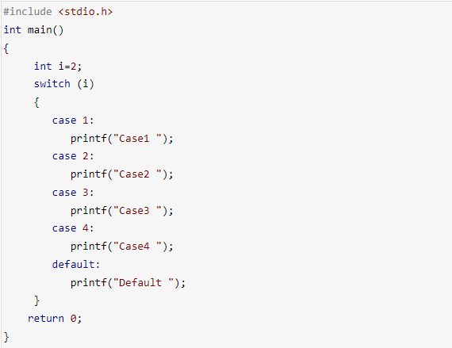

Switch case statement –Break statement

Slide 6
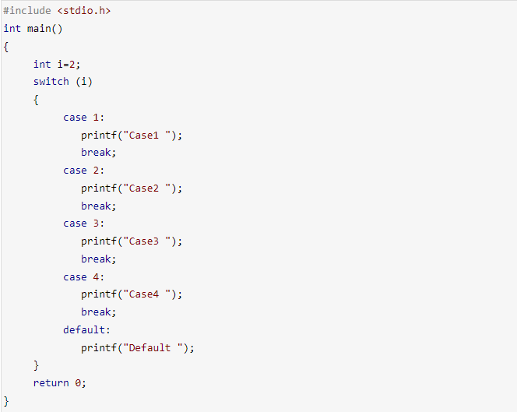
Solution

Slide 7
Task-1
Write a C++ program to input electricity unit charge and calculate the total electricity bill according to the given condition:
  For first 50 units Rs. 0.50/unit
  For next 100 units Rs. 0.75/unit
  For next 100 units Rs. 1.20/unit
  For unit above 250 Rs. 1.50/unit
  An additional surcharge of 20% is added to the bill.

Slide 8
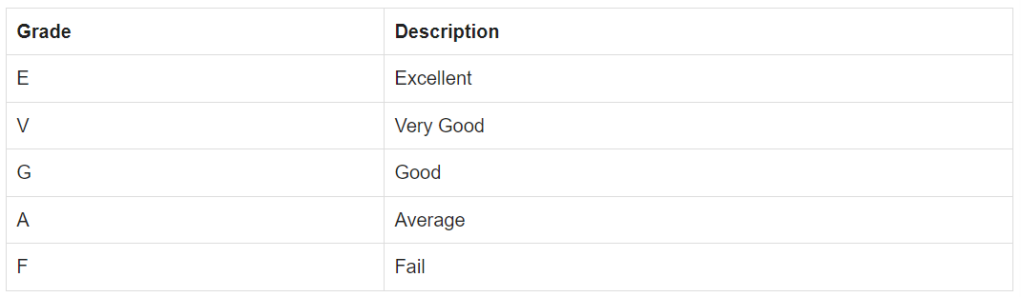
Task-2
Write a program in C to accept a grade and declare the equivalent description using switch-case statement :

Slide 9
Task-3
Write a program in C++ to read any digit (0-9) and display it in the word using switch-case statement.

